Slide 1
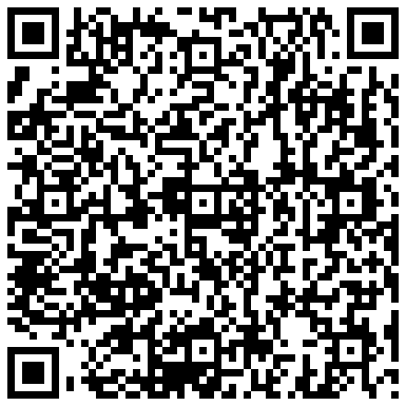

I can really do that? Free websites and software for the world language classroom.
Iris P. Myers
imyers@roanoke.edu
Christine S. Stanley
cstanley@roanoke.edu

Slide 2


Why do we use technology?
We should want our students to be able to do the following:
Make word clouds with

Slide 3
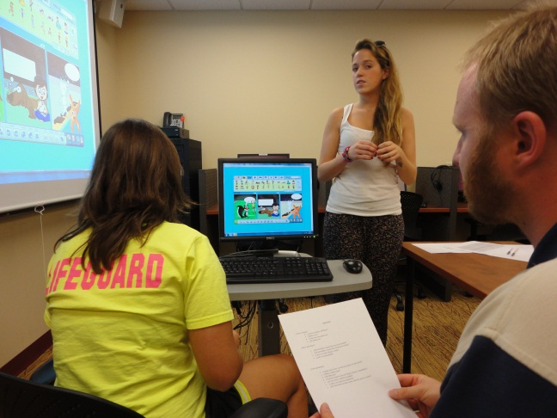
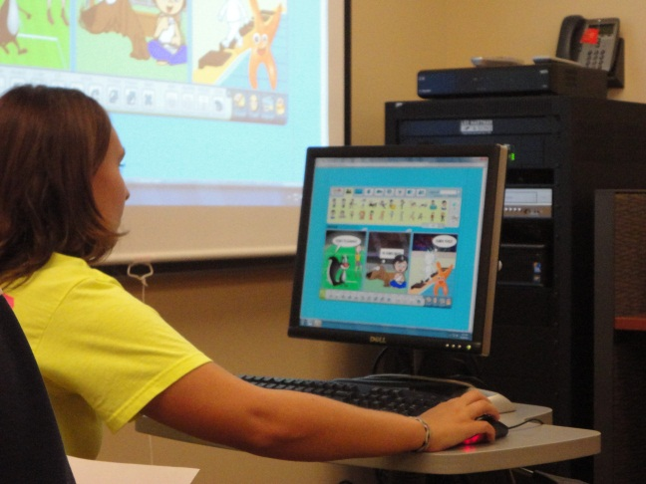
Toondoo
Create your own comic strips
Sign up for an individual account
Click on ToonDoo maker
Select a layout, many choices for the background, characters, text bubbles, etc.

Slide 4
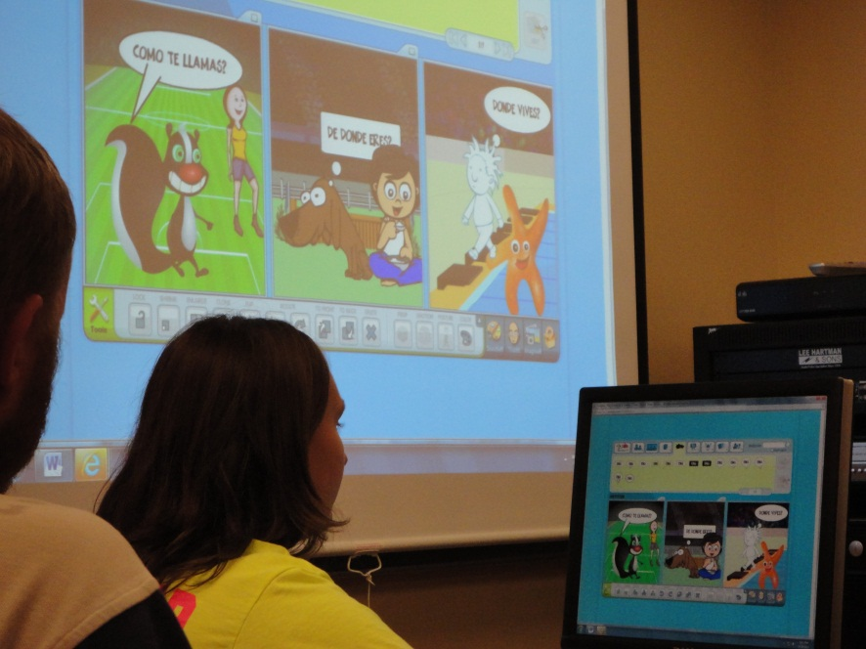
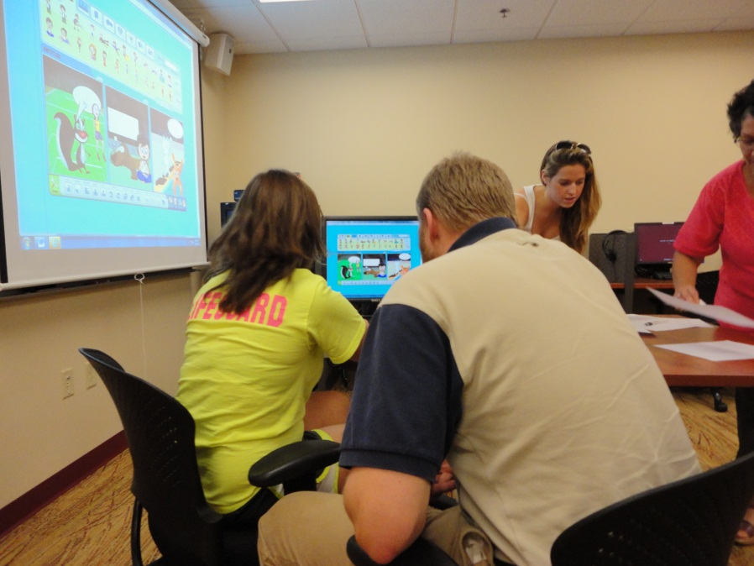
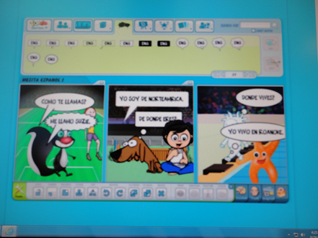
Mesita española with Toondoo

Slide 5


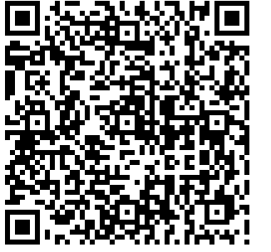
Making Apps and Qr Codes
AppsBar
This program will allow you to make your own apps for free in less than 30 minutes. AppsBar will also publish your app in the Android Market and in iTunes. No language programming is required to use this site.
Kaywa-Qr code maker
Kaywa will make a matrix barcode (Qr code)
that can be read with mobile phones that
have cameras.

Slide 6

Language Exchange Program:
The Mixxer hosted by Dickinson College
Language exchange program using Skype
Talk with native speakers over Skype
Write Blogs to receive comments and critiques
Has a good Frequently asked questions document for support, how to sign up, how to use the program
Use as an individual or as a large group
We came up with questions for the students to start out with on Skype

Slide 7
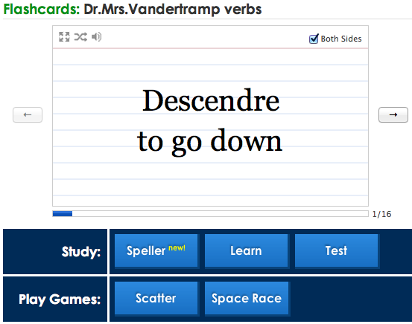
Vocabulary Builders
Text to Speech
This language portal can “read” text that has been added in the target language. Example in Italian Example in Spanish
Students can replay the file to practice their pronunciation or to “check” a paper by listening for errors that they miss in written text.
Quizlet (Online Flashcards with Sound Files)

Slide 8
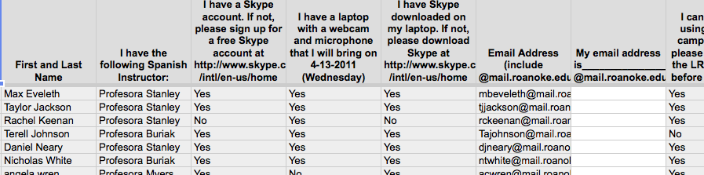
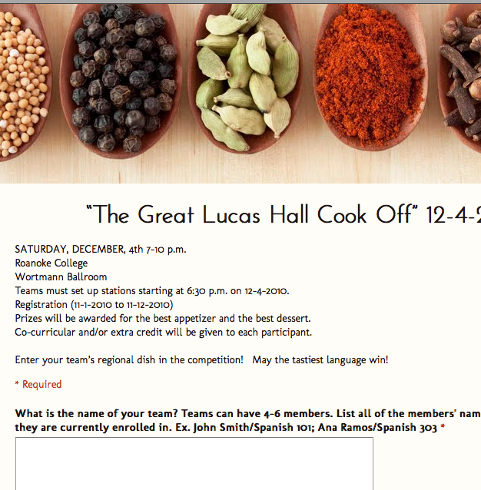
Google Documents
To make forms that can be used as sign up sheets for special events
Create an Account, Click on the Documents tool, Choose the option to create a Form
Insert a title, add any questions you want or need
Can change the theme to suit your needs
Google Documents Editor
Special Event Registration

Slide 9
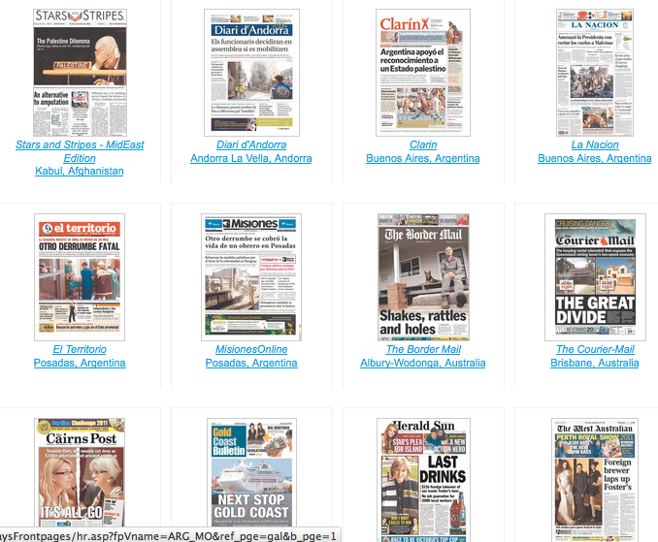
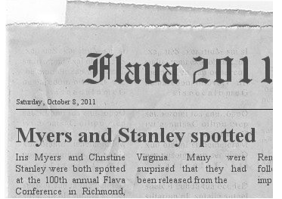
Newspapers
The Newseum offers the front page of newspapers from around the world.
Students can make their own newspaper snippets using Fodey.Com

Slide 10
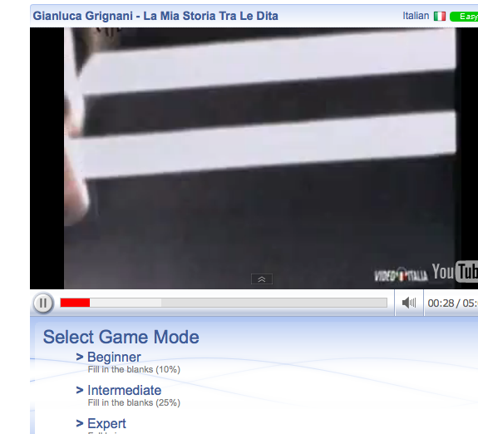

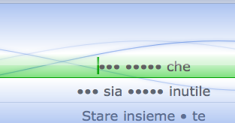
Lyrics Training
Easy and fun method to learn a foreign language through music.
Game like scenario to fill in the lyrics to popular music videos.
Different levels such as easy, medium, hard. (See examples)
Different languages including English, Spanish, French etc.
Program can also translate songs as you hear them.

Slide 11
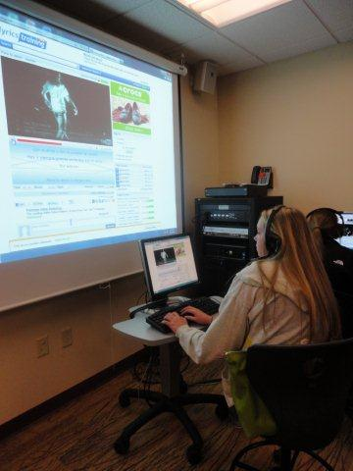
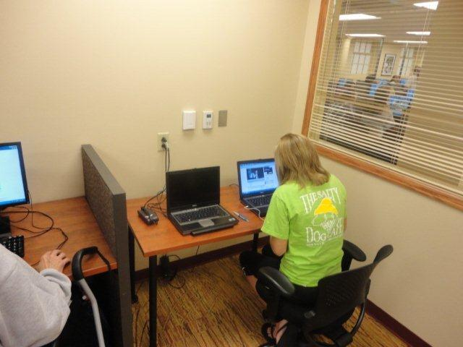
Mesita española with
Lyrics Training

Slide 12
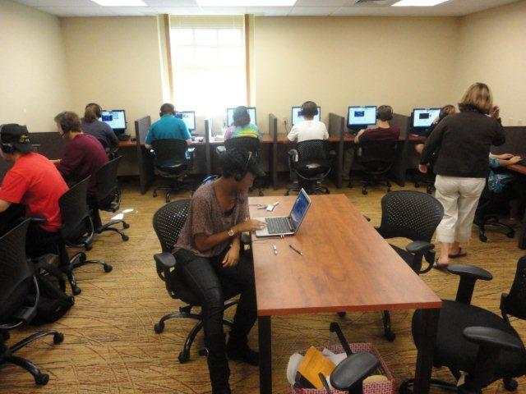
Mesita española with Lyrics Training

Slide 13
Culture:
Kwintessential
International Etiquette Guide for several countries around the world. Students can take fun cultural quizzes about etiquette, customs, and protocol.
Peace Corps
Bring dozens of Peace Corps Volunteer stories, letters, and folk tales with standards-based lessons to your class. Discover ways to involve students in service learning.
Correspondence Match
Peace Corps Volunteers abroad communicate
with U.S. classrooms.

Slide 14
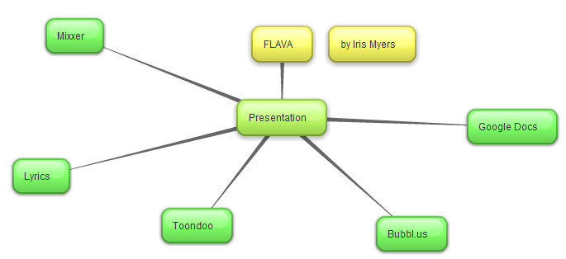
Bubblus
Mind mapping software that can be shared with others
Can be put into a blog or website

Slide 15
How to contact us:
Iris P. Myers
Roanoke College
Language Resource Center Director
Department of Modern Languages
030 Lucas Hall
540-375-2091
imyers@roanoke.edu
Christine S. Stanley
Roanoke College
Department of Modern Languages
108 Lucas Hall
540-378-5196
cstanley@roanoke.edu
Modern Languages

